Slide 2
Update on datasets
Update on Sample Sizes:
Have confirmed with Todd’s dump
Total of 8,702 individuals in 2009
Total of 7,929 individuals in 2019

Slide 4
Questions on analysis
Are the original MPLUS files avaliable? These just look to be dataset so would be curious if we could locate original datasets?
How to handle missing data?
Sensitivity analysis dropping values
Include missing category
Assume missingness patterns are related to other variables observed

Slide 5
Comparing Descriptive Statistics in 2009 of those in 2009 Sample Who Were Also in 2019 vs Those Not in 2019 **AGH add sample size**
 |  | In 2009 But Not in 2019 N= | In 2009 And in 2019 N =
Race/Ethnicity | White | 71% | 73%
 | Black | 10% | 11%
 | American Indian/Alaskan Native | 1% | 1%
 | Asian/Pacific Islander | 11% | 9%
 | Hispanic | 3% | 4%
 | Other | 4% | 2%
Age in 2009 |  | 47.9 | 45.2
% Female |  | 35% | 43%
Providing routine obstetric deliveries |  | 7% | 13%
Providing routine prenatal care | prenatal | 10% | 16%
Specialty | Family Medicine | 27% | 37%
 | General Internal Medicine | 44% | 28%
 | General Obstetrics and gynecology | 11% | 15%
 | General Pediatrics | 17% | 20%
 | Geriatrics | 0% | 1%
Urban/rural status | Urban | 80% | 81%
 | Large Rural | 14% | 14%
 | Small rural | 6% | 6%
Setting | Ambulatory Care | 38% | 66%
 | Hospital | 31% | 11%
 | Medical School/Parent university | 12% | 4%
 | Nursing home/extended care | 1% | 1%
 | Other | 2% | 1%
 | Solo practitioner | 9% | 13%
 | Missing | 8% | 5%
We so see some differences in analytic population
% Female is higher in LTA
Higher % of people in family medicine in LTA analytic sample
Lower % of internal medicine
Higher rates of individuals working in ambulatory settings, lower rates in hospital
Similar race/ethnicity and urban/rural
Flag ** those in ambulatory care

Slide 6
Comparing Descriptive Statistics in 2019 of those in 2019 Sample Who Were Also in 2009 vs Those Not in 2009
 |  | In 2019 But Not in 2009 | In 2009 And in 2019
Race/Ethnicity | White | 60% | 73%
 | Black | 11% | 11%
 | American Indian/Alaskan Native | 0% | 1%
 | Asian/Pacific Islander | 12% | 9%
 | Hispanic | 5% | 4%
 | Other ***ADD MISSING* ADD SAMPLE SIZES | 3% | 2%
Age in 2019 |  | 41 | 55
% Female |  | 60% | 43%
Providing routine obstetric deliveries |  | 16% | 10%
Providing routine prenatal care |  | 19% | 13%
Specialty | Family Medicine | 35% | 36%
 | General Internal Medicine | 27% | 25%
 | General Obstetrics and gynecology | 15% | 14%
 | General Pediatrics | 20% | 21%
 | Geriatrics | 3% | 3%
Urban/rural status | Urban | 86% | 82%
 | Large Rural | 11% | 13%
 | Small rural | 4% | 5%
Setting | Ambulatory Care | 44% | 62%
 | Hospital | 28% | 11%
 | Medical School/Parent university | 3% | 3%
 | Nursing home/extended care | 1% | 2%
 | Other | 9% | 8%
 | Solo practitioner | 3% | 11%
 | Missing | 12% | 4%
We so see some differences in analytic population
% Female is smaller in LTA
Similar rates of each specialty
Higher rates of individuals working in ambulatory settings, lower rates in hospital
Similar urban/rural but higher proportion of population is white in LTA

Slide 7
Comparisons of Specialty in 2009 vs. 2019
 |  | 2019
 |  | Family Medicine | Internal Medicine | General Obstetrics and Gynecology | General Pediatrics | Geriatrics
2009 | Family Medicine | 1,619 | 3 | 4 | 9 | 77
 | Internal Medicine | 22 | 1,156 | 0 | 40 | 50
 | General Obstetrics and Gynecology | 8 | 1 | 660 | 0 | 0
 | General Pediatrics | 6 | 6 | 0 | 919 | 1
 | Geriatrics | 1 | 6 | 0 | 0 | 23

Slide 8
Comparisons of Employment Settings in 2009 vs. 2019 **add total n** of 4,XXX (Sankey diagram)
 |  | 2019
 |  | Ambulatory Care | Hospital | Medical school/Parent University | Missing | Nursing home/extended care | Other | Solo Practitioner
2009 | Ambulatory Care | 2,320 | 208 | 15 | 124 | 29 | 207 | 133
 | Hospital | 135 | 204 | 10 | 25 | 8 | 86 | 21
 | Medical School/Parent University | 26 | 31 | 102 | 3 | 1 | 10 | 1
 | Missing | 132 | 30 | 9 | 15 | 3 | 25 | 23
 | Nursing home/extended care | 2 | 0 | 0 | 1 | 32 | 7 | 0
 | Other | 14 | 5 | 0 | 2 | 0 | 10 | 2
 | Solo Practitioner | 214 | 24 | 2 | 19 | 4 | 37 | 303

Slide 9
Changes in Urban/Rural Status
 |  | 2019
2009 |  | Large rural | Small rural | Urban
 | Large rural | 512 | 21 | 108
 | Small rural | 22 | 185 | 46
 | Urban | 62 | 31 | 3,626
Check on race/ethnicity changes

Slide 10
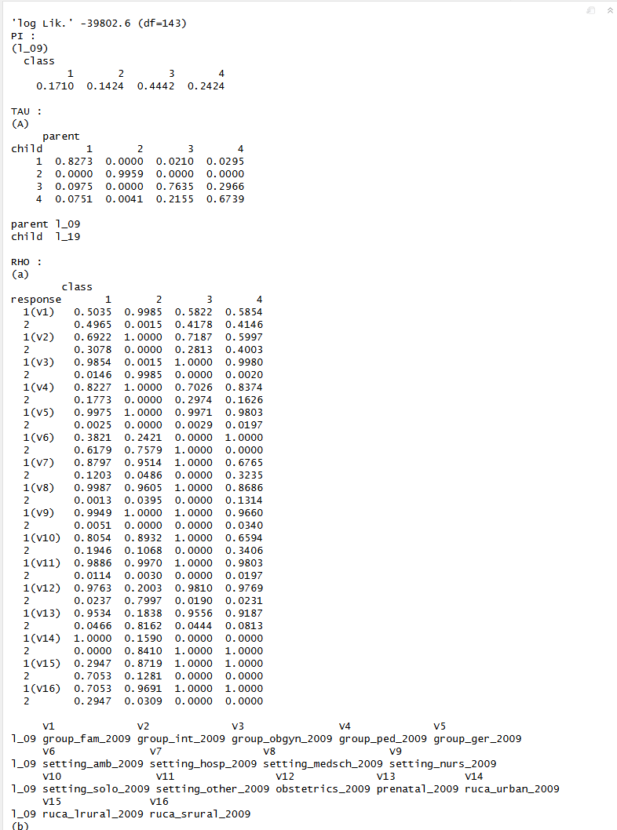
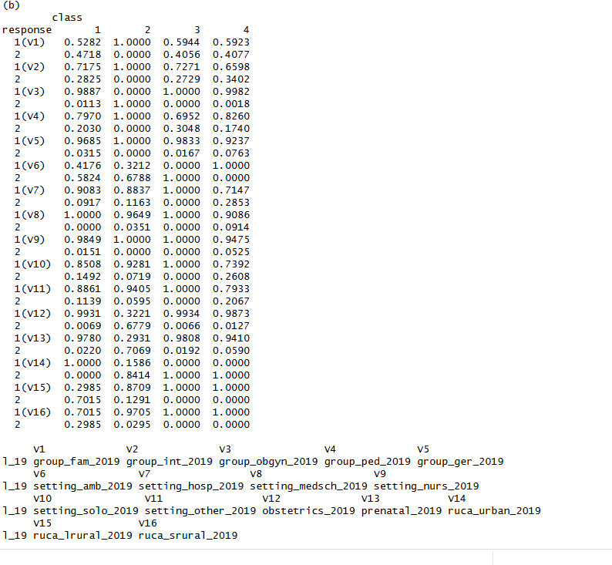

Slide 11
Latent Classes 2009
Class 1 (Navy) - Rural PCPs
Class 2 (Orange) – Urban, non-ambulatory care PCPs
Class 3 (Green) – Urban ambulatory care PCPs
Class 4 (Blue) - Ob-gyns (but no family medicine)

Slide 12
Latent Classes 2019
Class 1 (Navy) – Urban ambulatory care PCPs
Class 2 (Orange) - Rural PCPs
Class 3 (Green) – Urban, non-ambulatory care PCPs
Class 4 (Blue) - Ob-gyns (but no family medicine)

Slide 13
Transition Probabilities (FLIP THIS AROUND; sankeys; add ns)
 |  | Class Membership in 2009
 |  | Rural PCPs | Urban – Non-ambulatory care PCPs | Urban – Ambulatory Care PCPs | Ob-gyns (but no family practice) providing obstetric and prenatal care
Class Membership in 2019 | Rural PCPs | 0.837 | 0.029 | 0.021 | 0
 | Urban – Non-ambulatory care PCPs | 0.075 | 0.673 | 0.216 | 0.004
 | Urban – Ambulatory Care PCPs | 0.088 | 0.297 | 0.763 | 0
 | Urban Ob-gyns (but no family practice) | 0 | 0 | 0 | 0.996

Slide 14
Of family medince % with obstetric care
Output file to stata ** for sample for analysis***
Flag for 2019 vs. 2009***
Add in descriptives for classes within 2009
Add in descriptive for classes within 2019

